Slide 1
Single-Source Shortest Paths

Slide 2
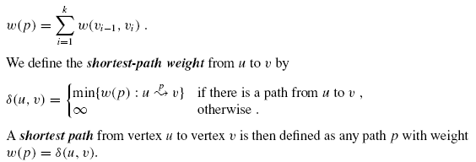
Single-Source Shortest Paths
In a shortest-paths problem, we are given a weighted, directed graph G = (V, E), with weight function w : E → R mapping edges to real-valued weights.
The weight of path p = v0, v1, . . . , vk is the sum of the weights of its constituent edges:

Slide 3
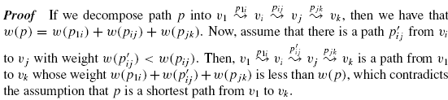
Optimal substructure of a shortest path
Shortest-paths algorithms typically rely on the property that a shortest path between two vertices contains other shortest paths within it.
Lemma (Subpaths of shortest paths are shortest paths)
Given a weighted, directed graph G = (V, E) with weight function w : E → R, let p = v₁, v₂, . . . , v_{k} be a shortest path from vertex v₁ to vertex v_{k} and, for any i and j such that 1 ≤ i ≤ j ≤ k, let p_{i j} = v_{i}, v_{i+1}, . . . , v_{j} be the subpath of p from vertex vi to vertex v_{j} . Then, p_{i} _{j} is a shortest path from v_{i} to v_{j} .

Slide 4
Negative weight edges
If the graph G = (V, E) contains no negative weight cycles reachable from the source s, then for all v ∈ V, the shortest-path weight δ(s, v) remains well defined, even if it has a negative value.
If there is a negative-weight cycle reachable from s, however, shortest-path weights are not well defined.
No path from s to a vertex on the cycle can be a shortest path—a lesser-weight path can always be found that follows the proposed “shortest” path and then traverses the negative-weight cycle.
If there is a negative-weight cycle on some path from s to v, we define δ(s, v) = −∞.

Slide 5
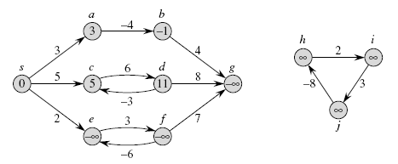
Negative weight edges (Example)
Shown within each vertex is its shortestpath weight from source s. Because
vertices e and f form a negative-weight cycle reachable from s, they have
shortest-path weights of −∞. Because vertex g is reachable from a vertex whose
shortestpath weight is −∞, it, too, has a shortest-path weight of −∞. Vertices such
as h, i, and j are not reachable from s, and so their shortest-path weights are ∞,
even though they lie on a negative-weight cycle.

Slide 6
Cycles
Can a shortest path contain a cycle?
As we have just seen, it cannot contain a negative-weight cycle.
Nor can it contain a positive-weight cycle, since removing the cycle from the path produces a path with the same source and destination vertices and a lower path weight.
That is, if p = v₀, v₁, . . . , v_{k} is a path and c = v_{i}, v_{i+1}, . . . , v_{j} is a positive-weight cycle on this path (so that v_{i} = v_{j} and w(c) > 0), then the path p’ = v₀, v₁, . . . , v_{i}, v_{j+1,} v_{j+2}, . . . , v_{k} has weight w(p’) = w(p) − w(c) < w(p), and so p cannot be a shortest path from v₀ to v_{k} .

Slide 7
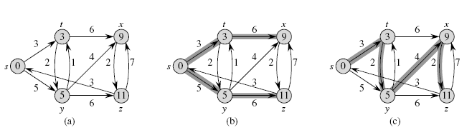
Shortest paths are not unique

Slide 8
Relaxation
This algorithms use the technique of relaxation.
For each vertex v ∈ V, we maintain an attribute d[v], which is an upper bound on the weight of a shortest path from source s to v. We call d[v] a shortest-path estimate.
We initialize the shortest-path estimates and predecessors by the following Θ(V)-time procedure.

Slide 9
Relaxation procedure
INITIALIZE-SINGLE-SOURCE(G, s)
1 for each vertex v ∈ V[G]
2 do d[v]←∞
3 π[v]← NIL
d[s] ← 0
The process of relaxing an edge (u, v) consists of testing whether we can improve the shortest path to v found so far by going through u and, if so, updating d[v] and π[v].

Slide 10
Relaxation
A relaxation step may decrease the value of the shortest-path estimate d[v] and update v’s predecessor field π[v]. The following code performs a relaxation step on edge (u, v).
RELAX(u, v, w)
1 if d[v] > d[u] + w(u, v)
2 then d[v] ← d[u] + w(u, v)
3 π[v]← u

Slide 11
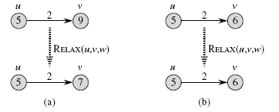
Example of relaxation
Figure shows two examples of relaxing an edge, one in which a shortest-path estimate decreases and one in which no estimate changes.

Slide 12
Relaxation
Each algorithm in this chapter calls INITIALIZE-SINGLE-SOURCE and then repeatedly relaxes edges.
Relaxation is the only means by which shortest path estimates and predecessors change.
The algorithms in this chapter differ in how many times they relax each edge and the order in which they relax edges.
In Dijkstra’s algorithm, each edge is relaxed exactly once.
In the Bellman-Ford algorithm, each edge is relaxed many times.

Slide 13
Properties of shortest paths and relaxation
Triangle inequality
For any edge (u, v) ∈ E, we have δ(s, v) ≤ δ(s, u) + w(u, v).
Upper-bound property
We always have d[v] ≥ δ(s, v) for all vertices v ∈ V, and once d[v] achieves the value δ(s, v), it never changes.
No-path property
If there is no path from s to v, then we always have
d[v] = δ(s, v)=∞.
Convergence property
If s →u → v is a shortest path in G for some u, v ∈ V, and if
d[u]= δ(s, u) at any time prior to relaxing edge (u, v),
then d[v] = δ(s, v) at all times afterward.

Slide 14
Properties of shortest paths and relaxation
Path-relaxation property
If p = v₀, v₁, . . . , v_{k} is a shortest path from s = v₀ to v_{k} , and the edges of p are relaxed in the order (v₀, v₁), (v₁, v₂), . . . , (v_{k−1}, v_{k} ), then d[v_{k} ] = δ(s, v_{k} ).
Predecessor-subgraph property
Once d[v] = δ(s, v) for all v ∈ V, the predecessor subgraph is a shortest-paths tree rooted at s.

Slide 15
Dijkstra’s algorithm
Dijkstra’s algorithm solves the single-source shortest-paths problem on a weighted, directed graph G = (V, E) for the case in which all edge weights are nonnegative.
Here we assume that w(u, v) ≥ 0 for each edge (u, v) ∈ E.

Slide 16
Working of Dijkstra’s algorithm
Dijkstra’s algorithm maintains a set S of vertices whose final shortest-path weights from the source s have already been determined.
The algorithm repeatedly selects the vertex u ∈ V − S with the minimum shortest-path estimate, adds u to S, and relaxes all edges leaving u.
In the following implementation, we use a min-priority queue Q of vertices, keyed by their d values.

Slide 17
Dijkstra’s algorithm
DIJKSTRA(G,w, s)
1 INITIALIZE-SINGLE-SOURCE(G, s)
2 S ← ∅
3 Q ← V[G]
4 while Q = ∅
5 do u ← EXTRACT-MIN(Q)
6 S ← S ∪ {u}
7 for each vertex v ∈ Adj[u]
8 do RELAX(u, v,w)

Slide 18
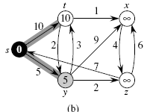
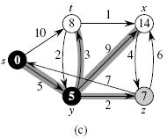
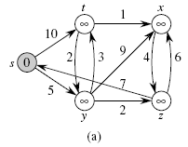
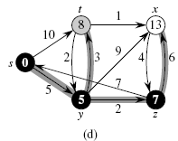
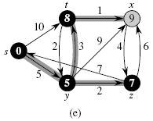
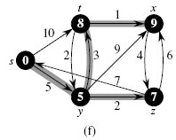
Disjkastra’s Example:

Slide 19
Dijkstra’s algorithm: Complexity
DIJKSTRA(G,w, s)
1 INITIALIZE-SINGLE-SOURCE(G, s)
2 S ← ∅
3 Q ← V[G]
4 while Q = ∅
5 do u ← EXTRACT-MIN(Q)
6 S ← S ∪ {u}
7 for each vertex v ∈ Adj[u]
8 do RELAX(u, v,w)
Complexity=?

Slide 20
Dijkstra’s algorithm: Complexity
DIJKSTRA(G,w, s)
1 INITIALIZE-SINGLE-SOURCE(G, s)
2 S ← ∅
3 Q ← V[G]
4 while Q = ∅
5 do u ← EXTRACT-MIN(Q)
6 S ← S ∪ {u}
7 for each vertex v ∈ Adj[u]
8 do RELAX(u, v,w)
Complexity: O(V+V+VlogV+ElogV)= O(ElogV)

